Slide 1
Project Competition
Andrew Wilson, Greg Lozada, Guilherme Pereira,
Jake Sherman, Jordan Moses, and Jordan Sasek

Slide 2
Roles
Front End: Andrew Wilson, Guilherme Pereira, Greg Lozada
Design, layout, interactables, testing
Back End: Jordan Moses, Jordan Sasek, Jake Sherman
Coding, implementation, debugging,

Slide 3
Project Overview
Sports league management system.
Create an account
Become a Manager, player, or just a spectator
Edit info
Sign up for events
View an upcoming calendar of events
View scores and stats from previous and ongoing games

Slide 4
Functionality
Users will gain access to their account by signing in with their username and password.
Manager permissions:
Create/Edit a team
Create /Edit an event
Accept join team requests
Player permissions:
Request to join a team
General account functions (Spectators and above):
View Scores
View Calendar
View Events
View Stats
Follow a Team

Slide 5
Schedule/Plan
Plan: Meetings are scheduled for every Tuesday from 1:00 - 2:00. Extra meetings are added as needed.
Schedule (From 10/24/2018 onward):
Week 1:
Front-End: Event setup/edit screens
Back-End: Home screen coding
Week 2:
Front-End: Customize, Following, and Join Team screens
Back-End: Implement Event and EventScore classes and code Event setup/edit screens
Week 3:
Front-End: Quick access toolbar for specific sports and Calendar
Back-End: Implement Team class, and code Customize, Following, and Join Team screens
Week 4:
Front-End: Refine Previous Weeks
Back-End: code Quick access toolbar and Calendar
Week 5:
Front-End: Refine Previous Weeks
Back-End: Refine Previous Weeks

Slide 6
Video
https://www.youtube.com/watch?v=29REEuZksag&feature=youtu.be

Slide 7
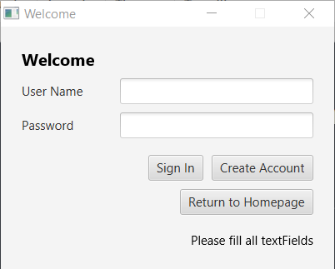
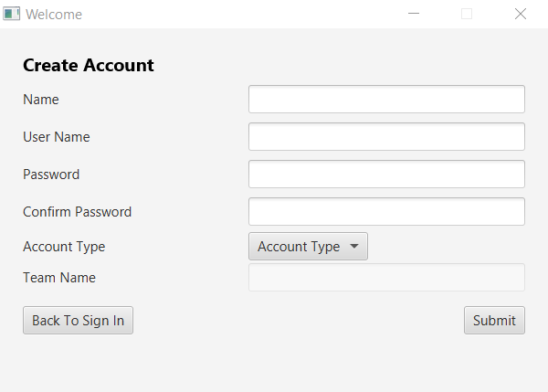
Screenshot Sign In/Create Account

Slide 8
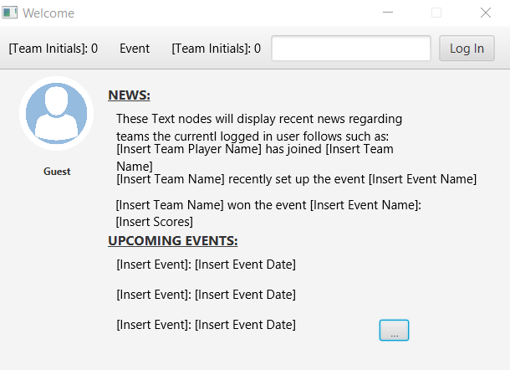
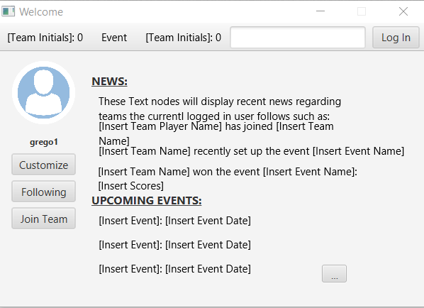
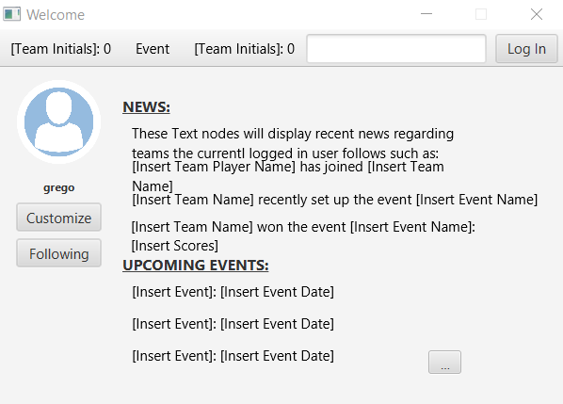
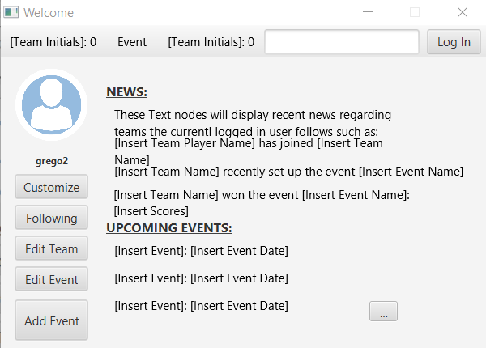
Screenshot Home Page

Slide 9
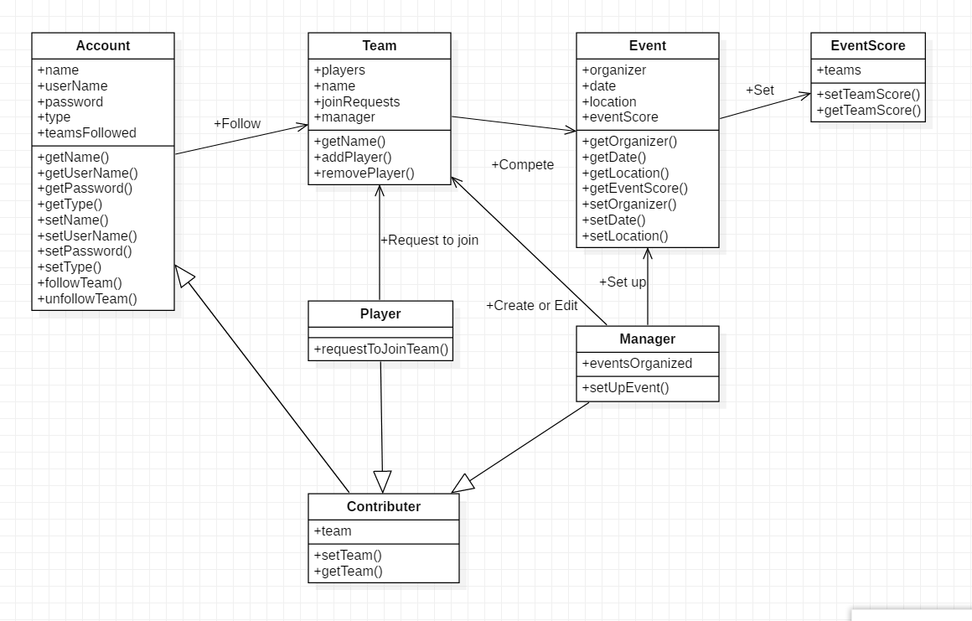
Design Overview

Slide 10
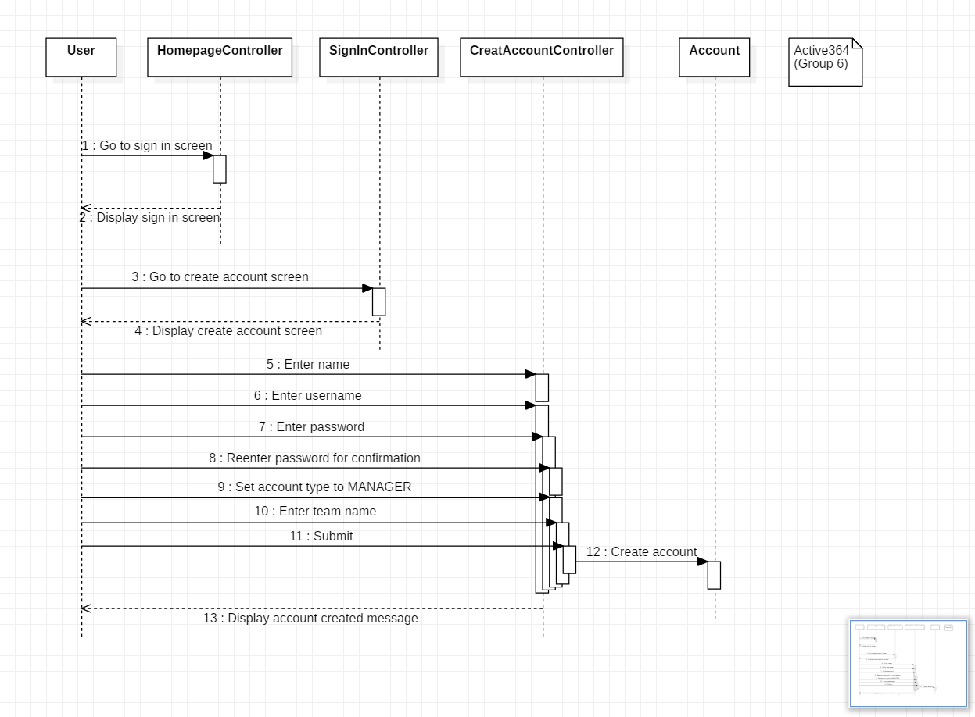
Sequence Diagram:
Creating a team manager account

Slide 11
Challenges and Decisions to be made
Challenges:
Document well enough to make it easy to add different functionality.
Figure out how to implement the program to work with a database to ensure users data is not lost.
Decisions:
Design/theme for our screens
Should we use CSS? How should it be formatted?

Slide 12
Next Tasks/Responsibilities
Back end:
Implement classes:
Contributor
Player
Manager
Team
Event
EventScore
Save accounts, teams, and events to a text file to be read when program begins running
Front end:
Design and implement:
Set up event screen
Edit event screen
Edit team screen
Profile customization screen
As well as setting up controllers for back end

Slide 13
Thank you for listening! Any Questions?

